Slide 1


Design patterns
Advanced Lecture
Ryan Ternier

Slide 2

Agenda
Design Pattern Overview
Factory Pattern
Strategy Pattern
Singleton
Observable
Notes:
Before we dive into the specifics of Strategy, Factory, Observable, and Singleton, I want to highlight something crucial:
Understanding the concepts and principles behind what you learn is key
In technology, tools and languages constantly evolve. Thus, mastering the syntax is less important than grasping the underlying ideas. These concepts form the backbone of all programming languages and design patterns, guiding you through any technology you encounter.
Today, as we explore different patterns, focus on the 'why' and 'when', not just the 'how'. This approach will empower you to apply these patterns effectively in real-world scenarios, adapting them to meet various challenges.
Let's embark on this journey with an open mind and a keen focus on the foundational concepts that make great programmers.

Slide 3
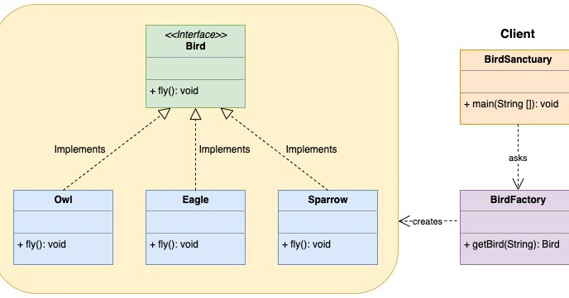
Factory Pattern
A creational pattern that uses factory methods to deal with creating objects.
Useful when a system should be independent of how its objects are created.
Notes:
Real-World Example: Logistics Management System
Scenario: A logistics company needs to handle different types of transport vehicles like trucks, ships, and airplanes.
Application of Factory Pattern:
A TransportFactory can be used to create different types of transport objects (Truck, Ship, Airplane) based on the requirement.
The system can decide at runtime which transport object to create, depending on factors like cargo size, destination, and cost.
This pattern centralizes vehicle creation, making it easier to add new transport types in the future.

Slide 4
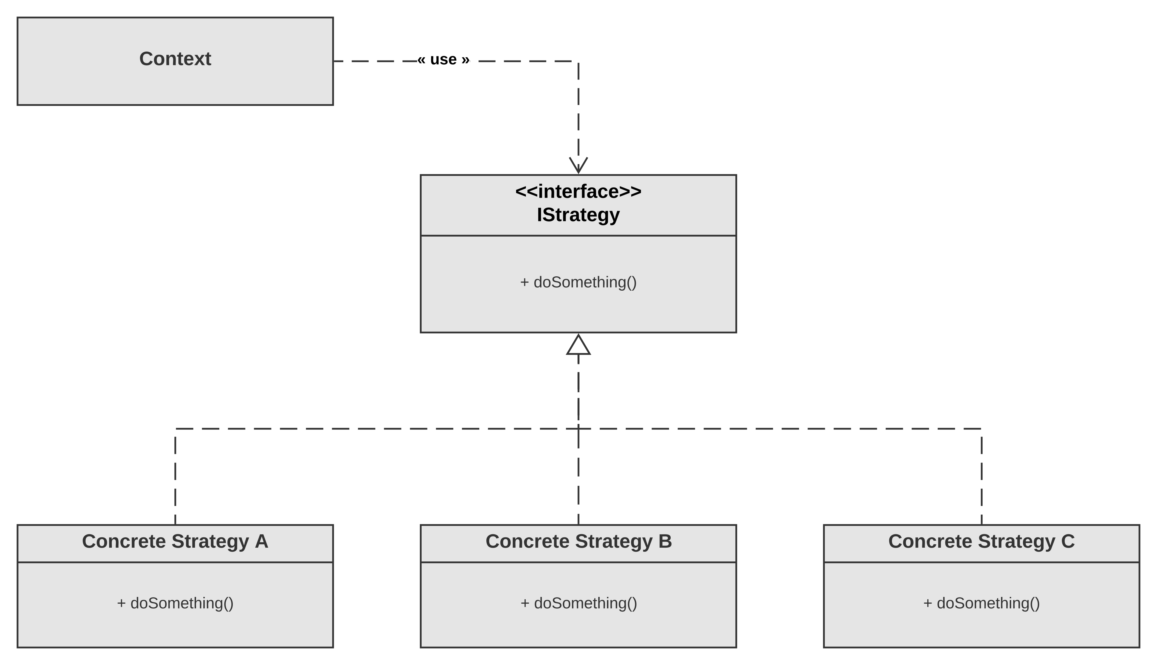
Strategy Pattern
A behavioral design pattern that enables selecting algorithms at runtime.
Ideal for situations with multiple ways of performing an operation.
Notes:
Defines a family of algorithms, encapsulates each one, and makes them interchangeable.
The strategy pattern lets the algorithm vary independently from clients that use it.
Real-World Example: Payment Processing Systems
Scenario: In an e-commerce platform, different types of payment methods (e.g., credit card, PayPal, cryptocurrency) are supported.
Application of Strategy Pattern:
Each payment method can be implemented as a strategy (e.g., CreditCardPayment, PayPalPayment, CryptoPayment).
The e-commerce system (Context) can switch between these payment strategies based on user choice without changing its codebase.
This approach allows easy addition of new payment methods without modifying existing code.

Slide 5
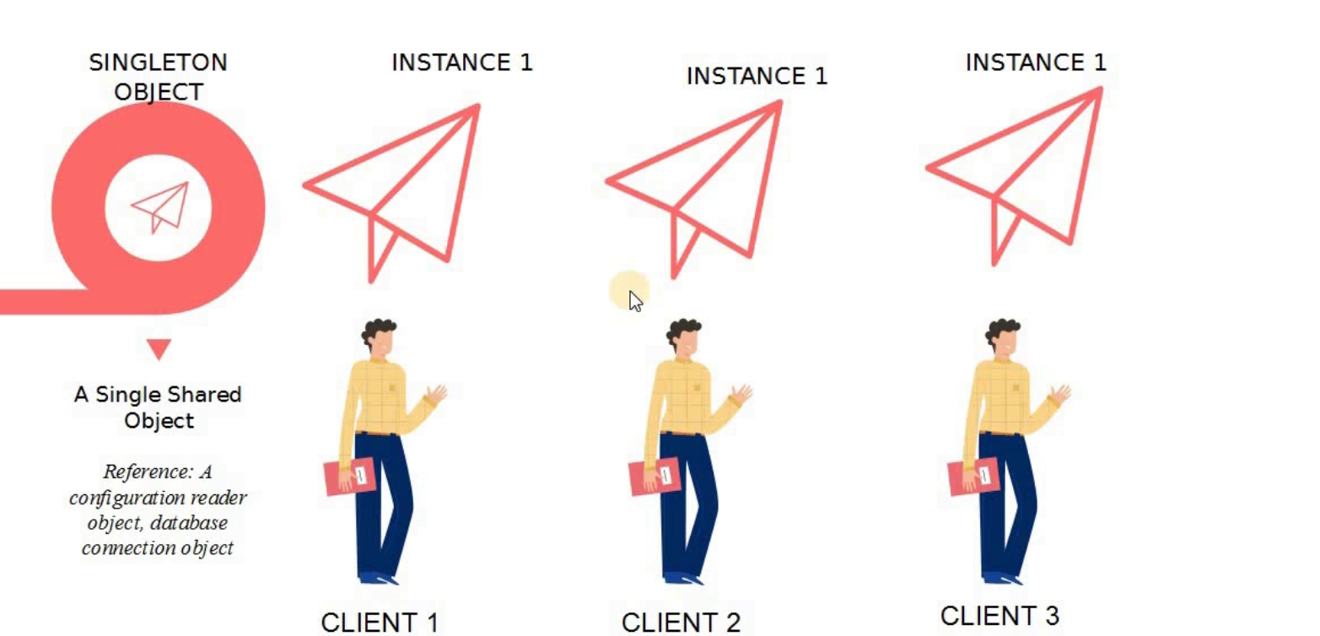
Singleton
A creational design pattern that ensures a class has only one instance while providing a global point of access to it.
Common in scenarios where a single object is required to coordinate actions across a system.
Notes:
Ensures that a class has only one instance and provides a global point of access to it.
Can be lazily loaded for efficiency and better resource management.
Real-World Example: Database Connection Pooling
Scenario: An application requires a managed pool of database connections that can be reused for database operations.
Application of Singleton Pattern:
The DatabaseConnectionPool class is designed as a Singleton to ensure only one instance manages all database connections.
This single instance controls the allocation and management of database connections, optimizing resource usage.
It guarantees that the pool is centrally managed and accessible throughout the application, preventing issues like connection leaks.

Slide 6
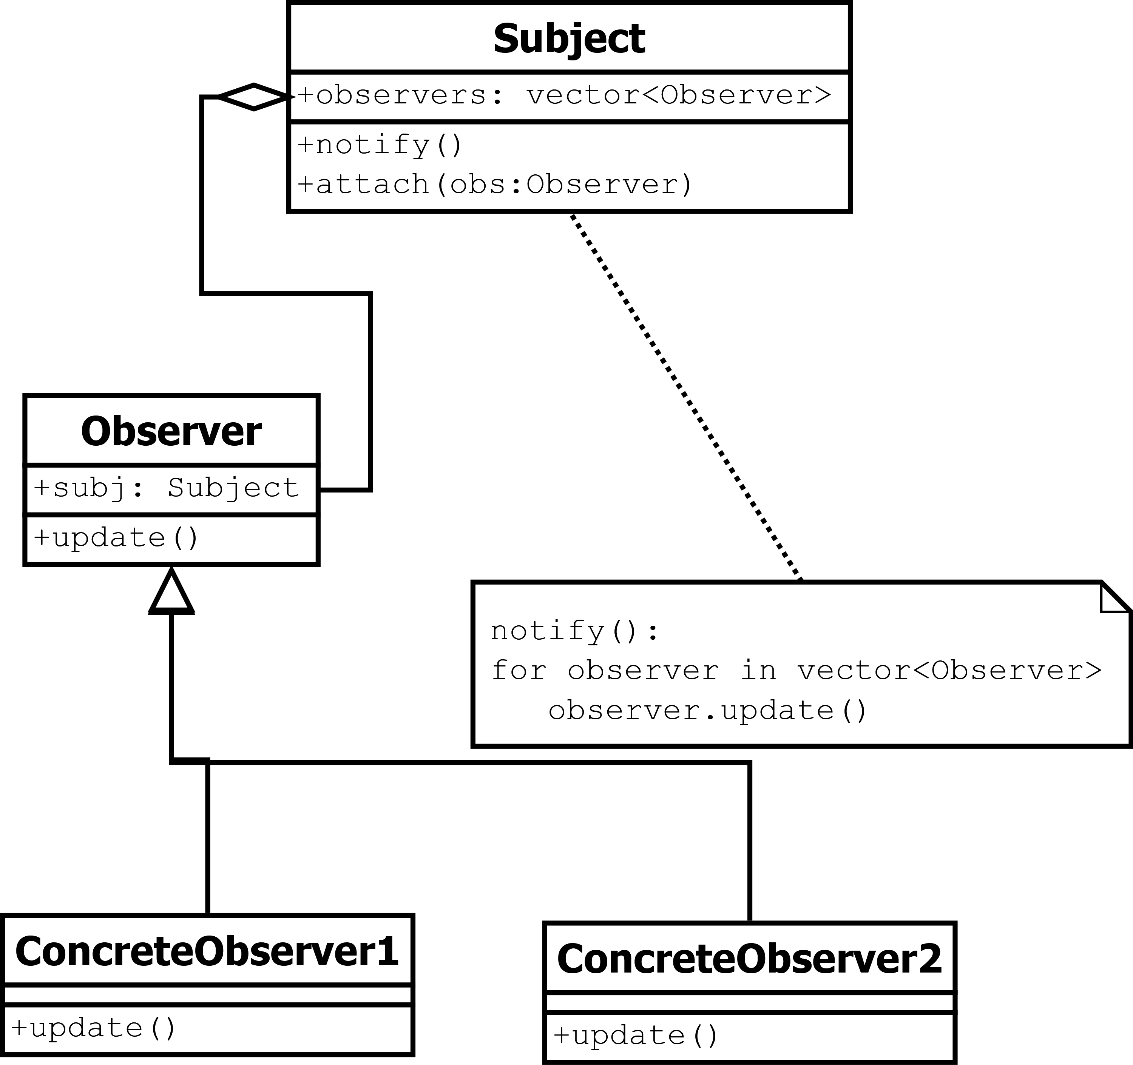
Observable Pattern
A behavioral pattern that defines a dependency between objects so that when one object changes its state, all its dependents are notified.
Commonly used for implementing distributed event handling systems.
Notes:
Consists of an Observable (subject) and Observers.
The Observable maintains a list of Observers and notifies them of state changes.
Real-World Example: Social Media Notifications
Scenario: In a social media app, users receive notifications when there are new posts or activities from their connections.
Application of Observable Pattern:
The social media platform acts as an Observable maintaining a list of subscribers (users) who are Observers.
Whenever a new post is made or an activity occurs, the platform notifies all subscribed users.
This pattern allows for dynamic subscription and notification, enabling real-time updates to users.

Slide 7

In Closing
CONCEPTS CONCEPTS CONCEPTS!
Understand the subject and concept, syntax can be taught.

